Slide 1

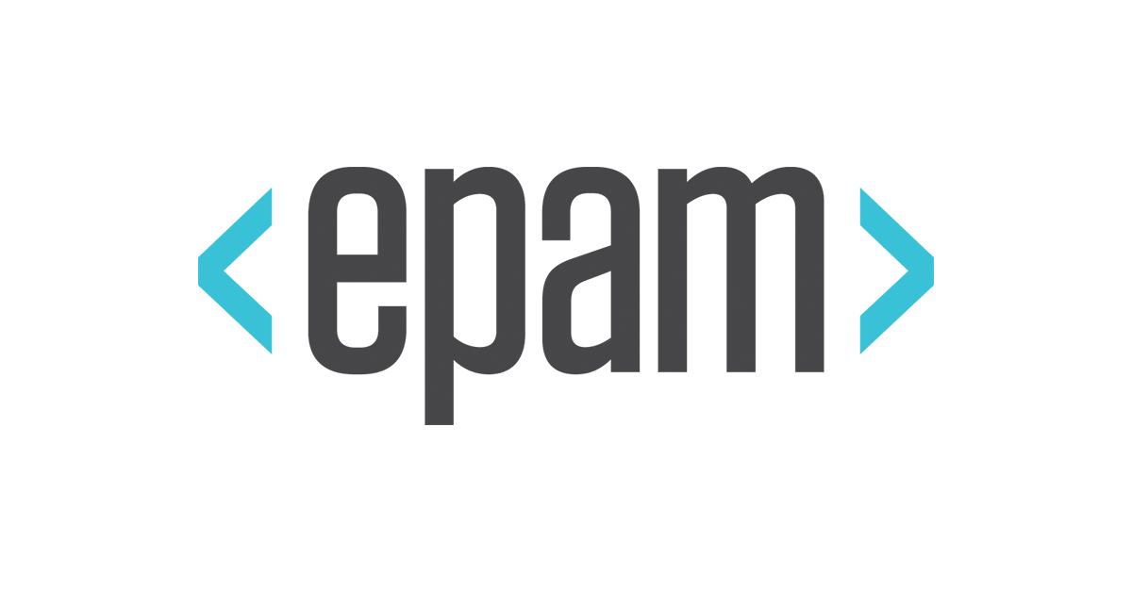
Final project DevOps_KhNURE_2019Q4
CI/CD pipeline for html page/web application
Ilya Chebotarev

Slide 2





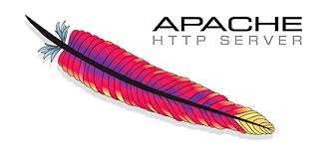
Apps and tech which I used in my project
1. GitHub - code version storage system.
2. Jenkins - is a free and open source automation server. Jenkins helps to automate the
non-human part of the software development process, with continuous integration and facilitating technical aspects of continuous delivery.
3. AWS – cloud provider.
4. Terraform - is an open source infrastructure as code software tool created by HashiCorp.
5. Docker - is a set of platform as a service products that uses OS-level virtualization to
deliver software in packages called containers.
6. Apache-server - is a free and open-source cross-platform web server software.

Slide 3

http://3.86.44.4/
HTML Page

Slide 4
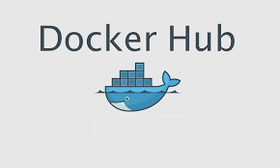


Schema of project
IP: 34.238.241.86:8080
PUSH
INIT
script.sh
COMMIT
PUSH
Docker pull
IP: 3.86.44.4

Slide 5


https://github.com/cheba-ilya/build
http://34.238.241.86:8080/job/docker_build/
GitHub
Jenkins

Slide 6


